Slide 1
Decision Tree
Prepared by
Said Fawzy
Manager of Information Center-Quality Manager
Tendering Department Arab Contractors

Slide 2
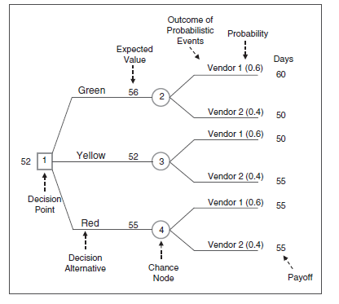
Decision Tree :

Slide 3

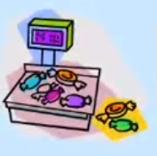
Simple Example On Decision Tree:

Slide 4
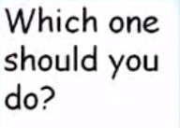


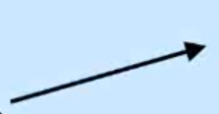

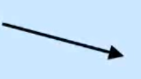


Slide 5












The procedure for solving a tree is called “rolling back” or “folding back” the tree.

Slide 6
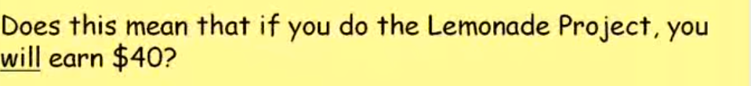
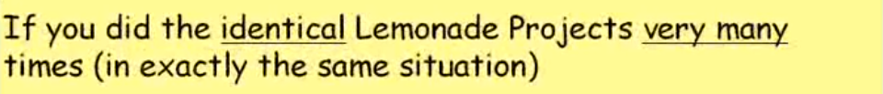

Slide 7
Financial Example on Decision Tree :

Slide 8

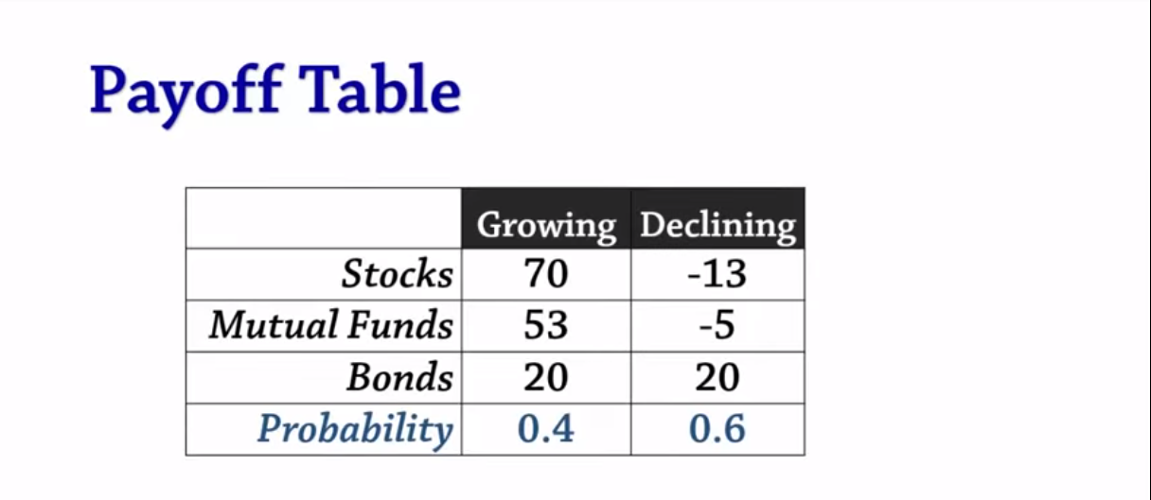
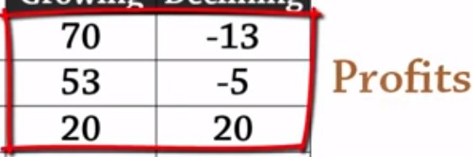
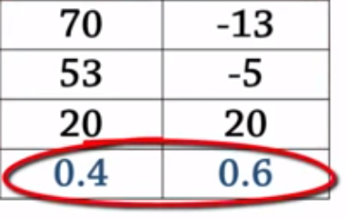

Slide 9

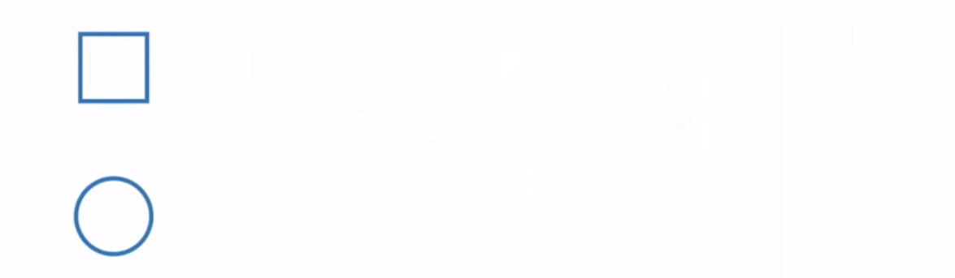
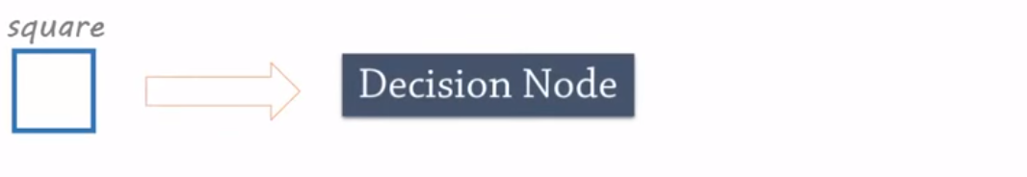
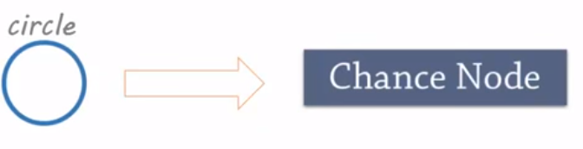


Slide 10
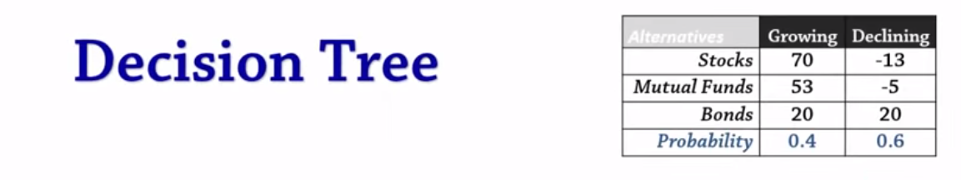
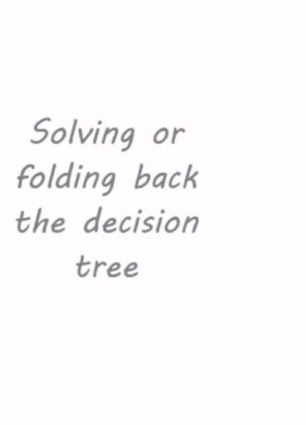

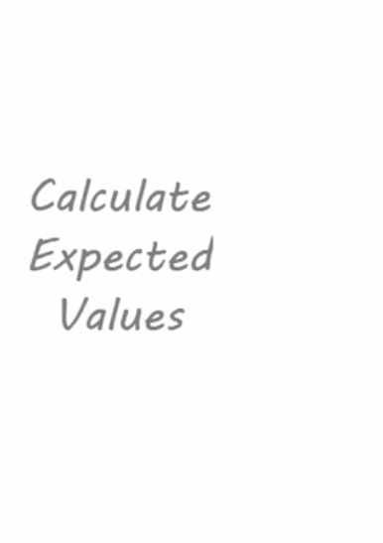
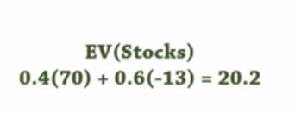
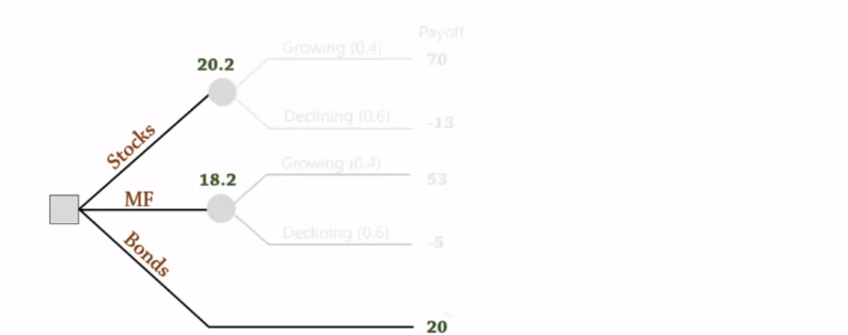

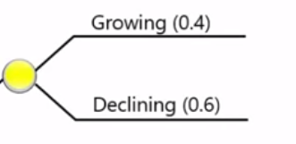

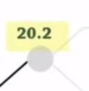

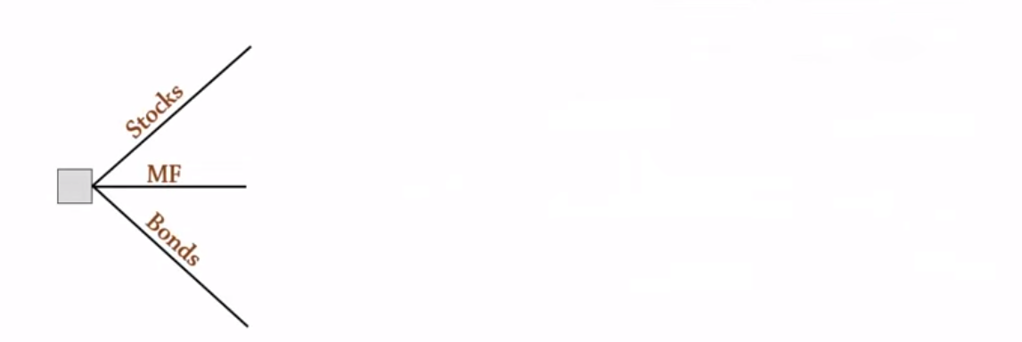
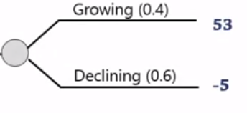




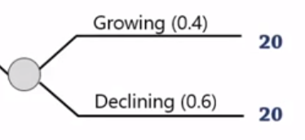
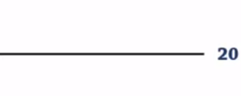

Slide 11
Problem : Electricity Plant

Slide 12
A government is making a decision of “Building new electricity plant” or “Upgrade the existing electricity plant”.
The Investment of building new one is 120 Million and the investment of upgrading the existing one is 50 Million.
They expected that the probability of having strong demand on the production is 60%.
If they build a new plant, the income of the plant is expected to be 200 Million in the upcoming 5 years if the demand is strong and 90 Million if the demand is weak.
In case of upgrading the existing one the income is expected to be 120 Million if the demand is so strong and 60 Million if the demand is weak.
Complete the following decision tree and calculate the “Expected Monetary Value” (EMV) in each case and help them take the decision:
Build new plant.
Renew the existing plant

Slide 13
Inc = 200 m
60%
Strong Demand
-120 +200 =80m
Inv = 120 m
Build
40%
Weak Demand
-120 +90 =(-30)m
Inc = 90 m
EMV = 0.6 X 80 + 0.4 X (-30) = 36 m
Build
or
Upgrade
Inc = 120 m
60%
Strong Demand
Inv = 50 m
-50 +120 =70m
Upgrade
Upgrade
40%
Weak Demand
-120 +60 =10m
EMV = 0.6 X 70 + 0.4 X 10 = 46 m
Inc = 60 m
Net part Value

